Slide 1

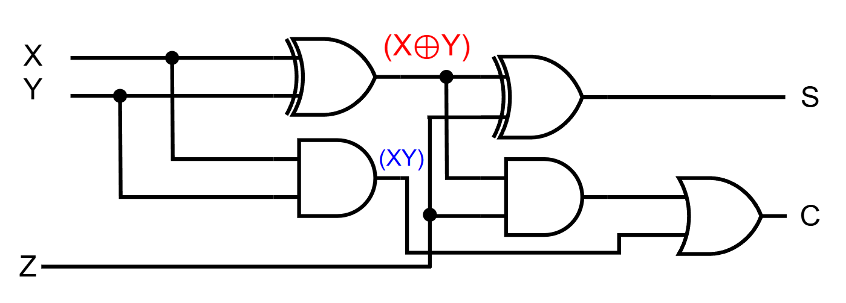
Department of Computer Science and Engineering, BRAC University
Lecture 6
Adder-Subtractor with Applications
CSE260 : Digital Logic Design

Slide 2
Half Adder
The combinational circuit that performs the addition of two bits is called a half-adder.
If the bits are X and Y, we will get C (Carry) & S (Sum)
X
+ Y
C S
X
Y
Half
Adder
S
C
(X + Y)
‹#›
Department of Computer Science and Engineering
CSE260 - Digital Logic Design

Slide 3
Half Adder
Now, we draw the truth table for all possible input combinations
0 0
+ 0 + 1
0 0 0 1
1 0
+ 0 + 0
0 1 1 0
X | Y | C | S
0 | 0 | 0 | 0
0 | 1 | 0 | 1
1 | 0 | 0 | 1
1 | 1 | 1 | 0
‹#›
Department of Computer Science and Engineering
CSE260 - Digital Logic Design

Slide 4
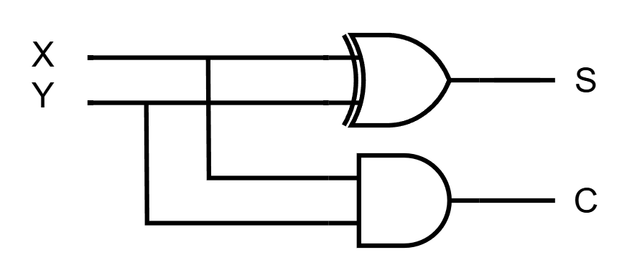
Half Adder
From the truth table, we find out the SOP to get the boolean function & simplify it.
C = XY
S = X'Y + XY' = X⊕Y
X | Y | C | S
0 | 0 | 0 | 0
0 | 1 | 0 | 1
1 | 0 | 0 | 1
1 | 1 | 1 | 0
Now, we draw the logic diagram.
‹#›
Department of Computer Science and Engineering
CSE260 - Digital Logic Design

Slide 5
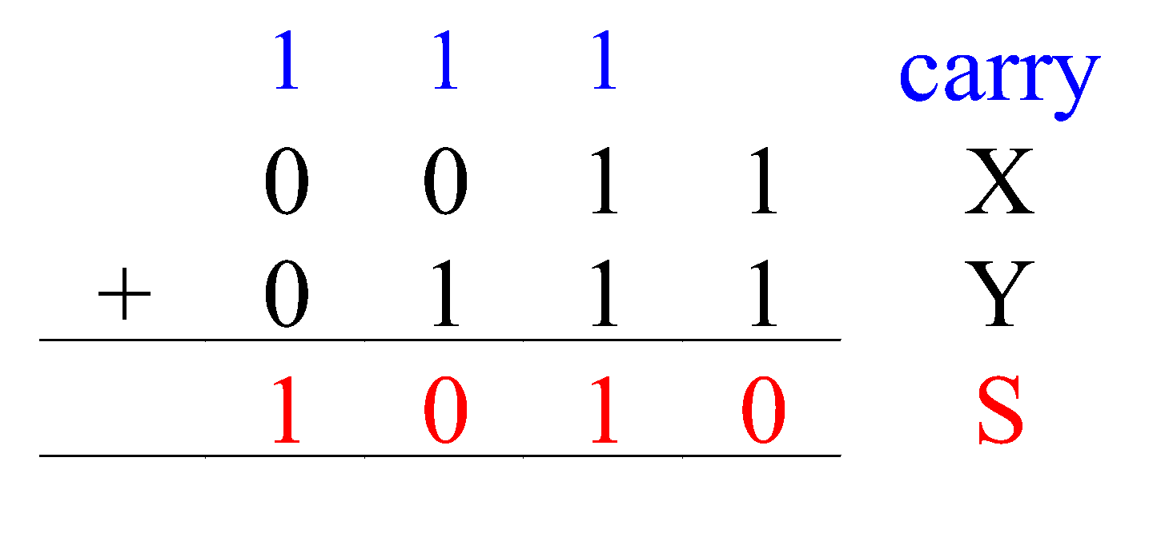
Full Adder
Half-adder adds up only two bits.
To add two binary numbers, we need to add 3 bits (including the carry).
Example:
Need Full Adder (so called as it can be made from two half-adders).
X
Y
Z
Full
Adder
S
C
(X + Y + Z)
‹#›
Department of Computer Science and Engineering
CSE260 - Digital Logic Design

Slide 6
Full Adder
From the truth table, we find out the SOP to get the boolean function & simplify it.
Note:
Z - carry in (to the current position)
C - carry out (to the next position)
X | Y | Z | C | S
0 | 0 | 0 | 0 | 0
0 | 0 | 1 | 0 | 1
0 | 1 | 0 | 0 | 1
0 | 1 | 1 | 1 | 0
1 | 0 | 0 | 0 | 1
1 | 0 | 1 | 1 | 0
1 | 1 | 0 | 1 | 0
1 | 1 | 1 | 1 | 1
C = X’YZ + XY’Z + XYZ’ + XYZ
S = X'Y'Z + XYZ + X'YZ' + XY'Z'
‹#›
Department of Computer Science and Engineering
CSE260 - Digital Logic Design

Slide 7
Full Adder
Simplifying,
C = X’YZ + XY’Z + XYZ’ + XYZ
= Z (X’Y + XY’) + XY (Z + Z’)
= Z (X ⊕ Y) + XY
S = X’Y’Z + X’YZ’ + XY’Z’ + XYZ
= X’ (Y’Z + YZ’) + X (Y’Z’ + YZ)
= X’ (Y⊕ Z) + X (Y⊕ Z)’ [(Y ⊕ Z) = A]
= X’A + XA’
= X ⊕ A
= X ⊕ Y ⊕ Z
‹#›
Department of Computer Science and Engineering
CSE260 - Digital Logic Design

Slide 8
Full Adder
Circuit
‹#›
Department of Computer Science and Engineering
CSE260 - Digital Logic Design

Slide 9
Why It Is Called Full Adder?
Full Adder made from two Half-Adders (+ OR gate).
‹#›
Department of Computer Science and Engineering
CSE260 - Digital Logic Design

Slide 10
4-bit Parallel Adder
Consider a circuit to add two 4-bit numbers together and a carry-in, to produce a 5-bit result:
X₃
X₂
X₁
X₀
Y₃
Y₂
Y₁
Y₀
4-bit
Parallel Adder
C₄
C₀
Black-box view of 4-bit parallel adder
S₃
S₂
S₁
S₀
5-bit result is sufficient because the largest result is:
(1111)₂+(1111)₂+(1)₂ = (11111)₂
‹#›
Department of Computer Science and Engineering
CSE260 - Digital Logic Design

Slide 11
4-bit Parallel Adder
SSI design technique should not be used.
Truth table for 9 inputs very big, i.e. 29=512 entries:
X₃X₂X₁X₀ | Y₃Y₂Y₁Y₀ | C₀ | C₄ | S₃S₂S₁S₀
0 0 0 0 | 0 0 0 0 | 0 | 0 | 0 0 0 0
0 0 0 0 | 0 0 0 0 | 1 | 0 | 0 0 0 1
0 0 0 0 | 0 0 0 1 | 0 | 0 | 0 0 0 1
… | … | … | … | …
0 1 0 1 | 1 1 0 1 | 1 | 1 | 0 0 1 1
… | … | … | … | …
1 1 1 1 | 1 1 1 1 | 1 | 1 | 1 1 1 1
Simplification very complicated as no. of input is 9 so 512(=2⁹) possible combination will be there in truth table!
‹#›
Department of Computer Science and Engineering
CSE260 - Digital Logic Design

Slide 12
4-bit Parallel Adder
Alternative design possible.
Addition formula for each pair of bits (with carry in),
C_{i+1}S_{i} = X_{i} + Y_{i} + C_{i}
has the same function as a full adder.
C_{i+1} = X_{i} Y_{i} + (X_{i} ⊕ Y_{i} ) C_{i}
S_{i} = X_{i} ⊕ Y_{i} ⊕ C_{i}
NB: Similar to FA equation
C = XY + (X⊕Y)Z
S = (X⊕Y)⊕Z
‹#›
Department of Computer Science and Engineering
CSE260 - Digital Logic Design

Slide 13
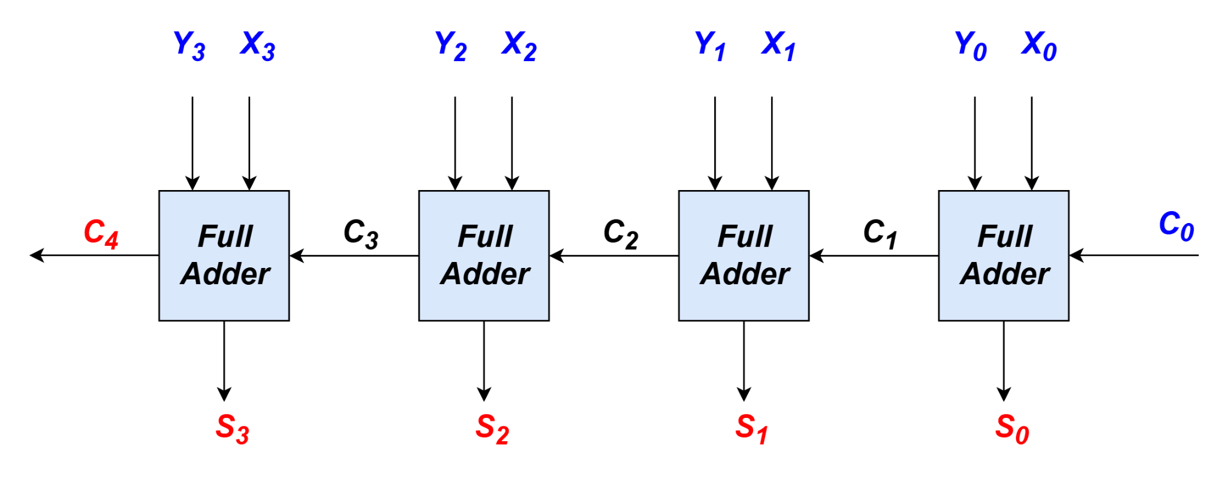
4-bit Parallel Adder
Cascading 4 full adders via their carries, we get:
Input
Output
n-bit parallel adder requires n full- adders
‹#›
Department of Computer Science and Engineering
CSE260 - Digital Logic Design

Slide 14
Examples
Simple examples using 4-bit parallel adder as building blocks:
Adder cum Subtractor
16-Bit Parallel Adder
BCD to excess 3 code converter
‹#›
Department of Computer Science and Engineering
CSE260 - Digital Logic Design

Slide 15
4-bit Parallel Adder-Subtractor
Subtraction can be performed through addition using 2s-complement numbers.
Hence, we can design a circuit which can perform both addition and subtraction, using a parallel adder.
X₃
X₂
X₁
X₀
Y₃
Y₂
Y₁
Y₀
4-bit
Parallel Adder
S: control signal for add/subtract
Result: either X+Y or X-Y
‹#›
Department of Computer Science and Engineering
CSE260 - Digital Logic Design

Slide 16
4-bit Parallel Adder-Subtractor
Design requires:
(i) XOR gates:
Y
Y
Y
Y’
S = 0
S = 1
such that: output = Y when S=0
= Y' when S=1
(ii) S connected to carry-in.
S | Y | Output
0 | 0 | 0
0 | 1 | 1
1 | 0 | 1
1 | 1 | 0
‹#›
Department of Computer Science and Engineering
CSE260 - Digital Logic Design

Slide 17
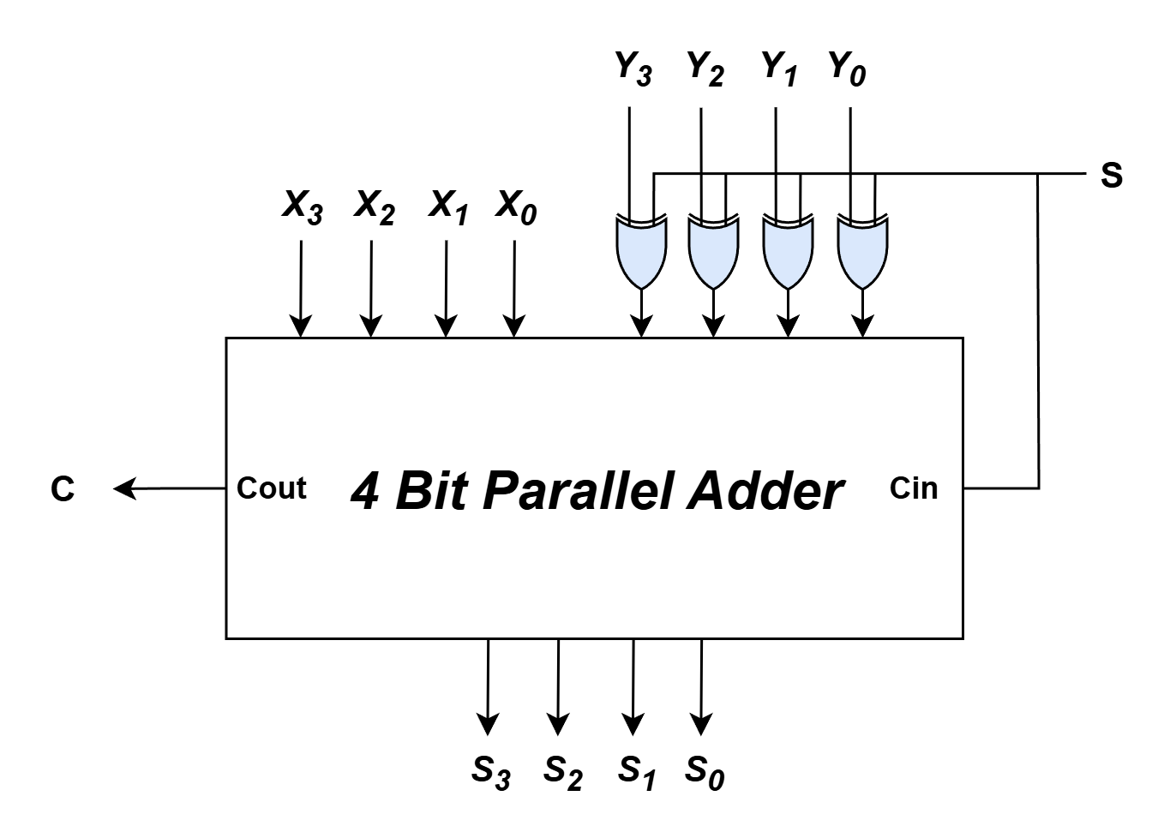
4-bit Parallel Adder-Subtractor
Adder cum subtractor circuit:
Analysis:
If S=1, then
X + (1's complement of Y) +1
appears as the result.
If S=0, then X+Y appears as
the result.
‹#›
Department of Computer Science and Engineering
CSE260 - Digital Logic Design

Slide 18

Example
Applications: Condition Based Adder Subtractor
Design a circuit that takes two binary number A, B and performs A-B, if certain condition is met or else perform A+B
Two Methods
Brute Force Approach: Find the minterms and use the SOP(s) directly
Smart Approach: Find existing patterns within the SOP(s)
‹#›
Department of Computer Science and Engineering
CSE260 - Digital Logic Design

Slide 19
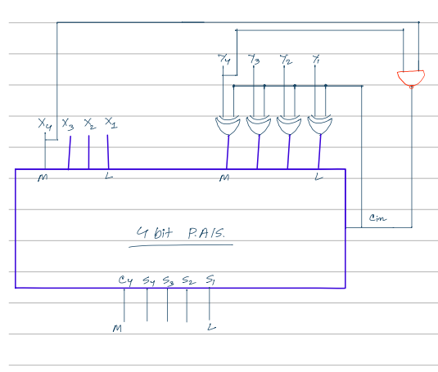
Example
Build a calculator that can add or subtract two 4-bit numbers: X and Y. Now, if both of the numbers are greater than or equal to 8, then the calculator will do the operation X+Y (addition). Otherwise, the calculator will do the operation X-Y(subtraction). Design the circuit using a 4-bit parallel adder-subtractor.
‹#›
Department of Computer Science and Engineering
CSE260 - Digital Logic Design

Slide 20
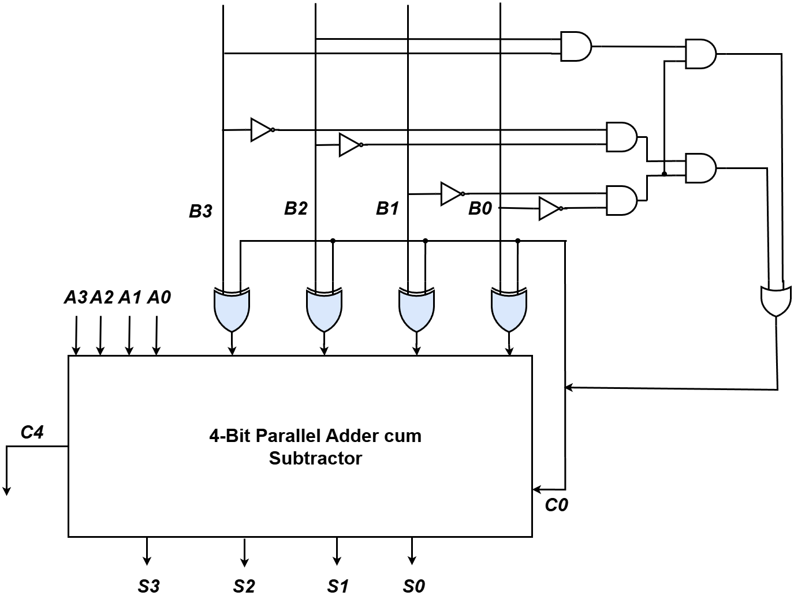
Example
Perform A-B, if B is Divisible by 12 using Brute Force Approach
Minterm | Product
0 | B₃’B₂’B₁’B₀’
12 | B₃B₂B₁’B₀’
Only the numbers 0 and 12 are divisible by 12 among all 4-bit numbers, So the following expression will solve the problem,
F(B₃,B₂,B₁,B₀) = B₃B₂B₁'B₀' + B₃'B₂'B₁'B₀'
If the number of minterm increases, you may use KMAP to simplify the circuit.
‹#›
Department of Computer Science and Engineering
CSE260 - Digital Logic Design

Slide 21
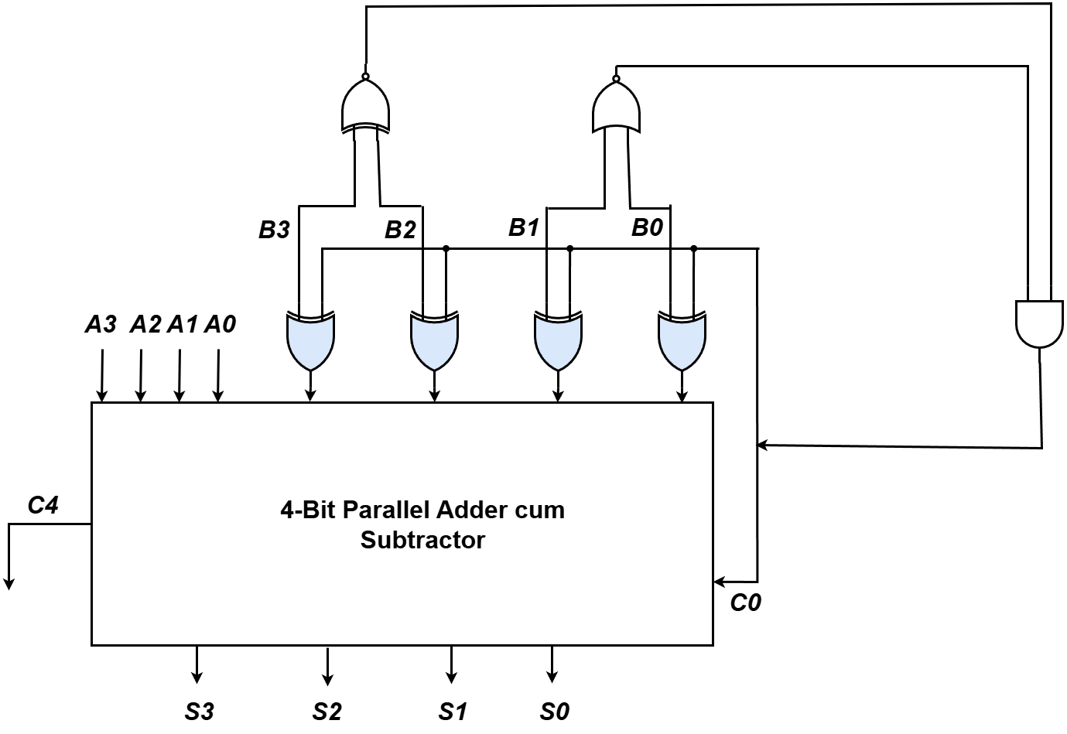
Example
Perform A-B, if B is Divisible by 12 using Patterns
Possible combinations among B₃ and B₂ are 00 and 11, hence XNOR gate was used to combine them as only XNOR gate will provide 1 for these two unique combinations. NOR gate was used for latter variables for the same reason.
Finally, combining them with AND gate ensures the output of the AND gate will only be 1 if the current combination is indeed divisible by 12. If C₀ receives 1 then it will perform A-B.
‹#›
Department of Computer Science and Engineering
CSE260 - Digital Logic Design

Slide 22
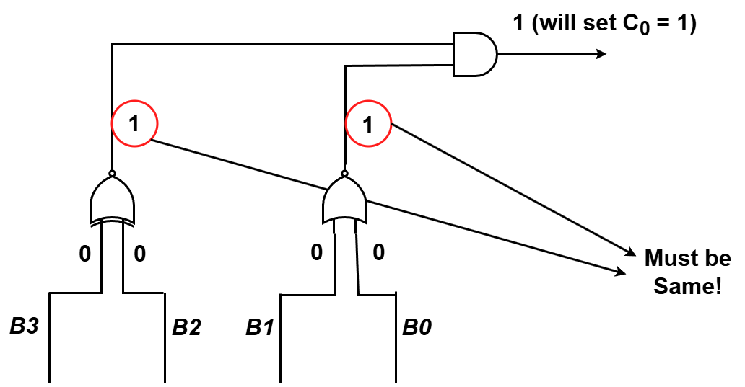
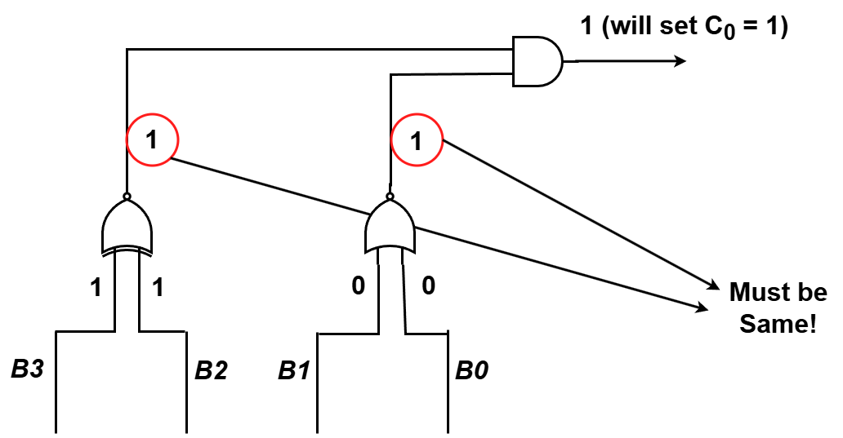
Example
Perform A-B, if B is Divisible by 12 using Patterns (Cont)
The solution is simulated for both valid combinations who are divisible by 12, 0000 and 1100. The red circled elements indicate that the output of the intermediary gates cannot mismatch, any mismatch in those circled outputs means that the current combination is not divisible by 12 and the final output will give 0 which will result in C₀ being 0 hence, performing A+B likewise
‹#›
Department of Computer Science and Engineering
CSE260 - Digital Logic Design

Slide 23
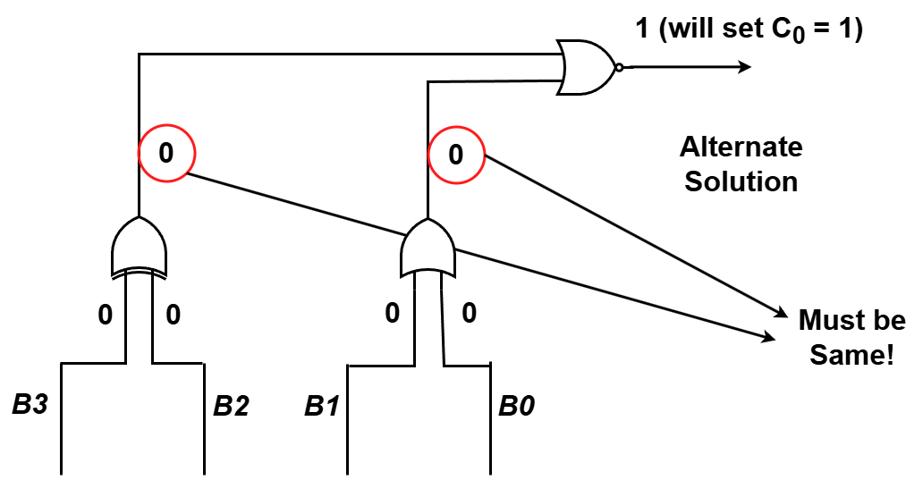
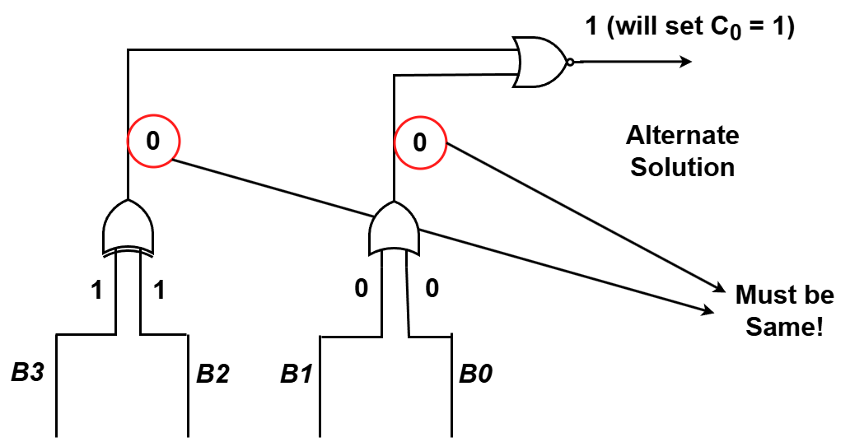
Example
Perform A-B, if B is Divisible by 12 using Patterns (Alternate Solution)
The alternate solution using different logic gates also fulfill the same logic
‹#›
Department of Computer Science and Engineering
CSE260 - Digital Logic Design

Slide 24
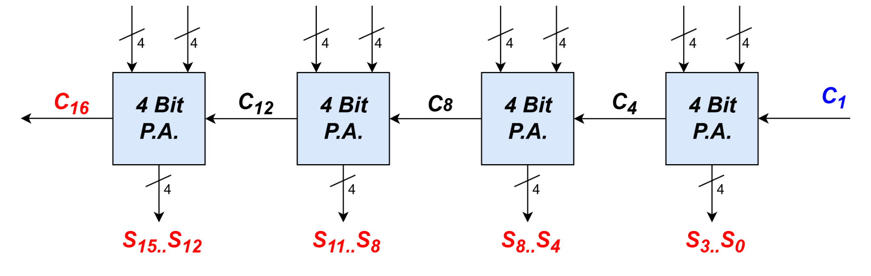
16-bit Parallel Adder
Larger parallel adders can be built from smaller ones.
Example: a 16-bit parallel adder can be constructed from four 4-bit parallel adders:
X₁₅…X₁₂
Y₁₅…Y₁₂
X₁₁…X₈
Y₁₁…Y₈
X₇…X₄
Y₇…Y₄
X₃…X₀
Y₃…Y₀
‹#›
Department of Computer Science and Engineering
CSE260 - Digital Logic Design

Slide 25
16-bit Parallel Adder
Shortened notation for multiple lines.
16-bit parallel adder ripples carry from one 4-bit block to the next.
Such ripple-carry circuits are “slow” because of long delays needed to propagate the carries.
4
is a shortened notation for
S₃ .. S₀
S₃ S₂ S₁ S₀
‹#›
Department of Computer Science and Engineering
CSE260 - Digital Logic Design

Slide 26
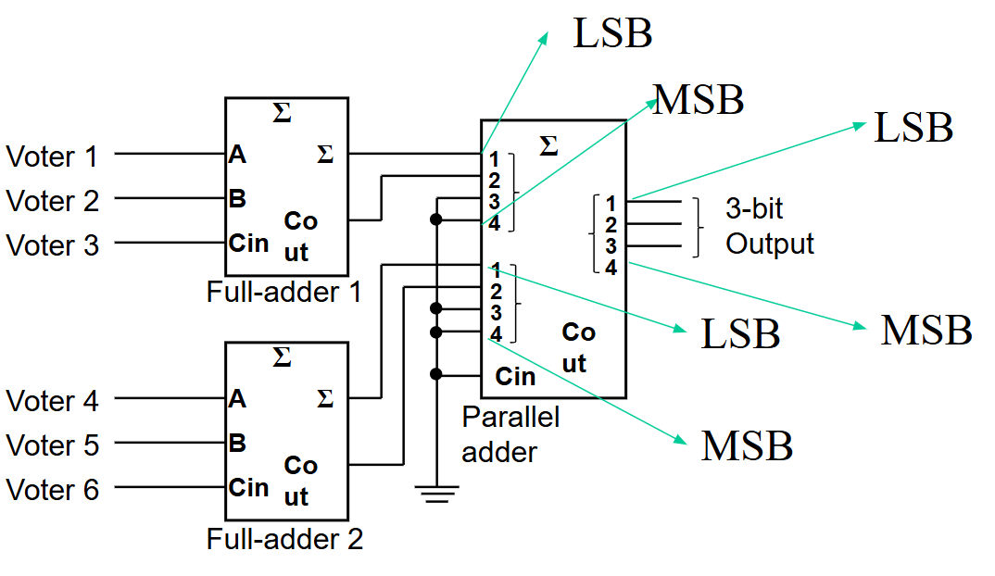
Arithmetic Circuits: Cascading Adders
Application: 6-person voting system.
Use FAs and a 4-bit binary parallel adder.
Each FA can sum up to 3 votes.
‹#›
Department of Computer Science and Engineering
CSE260 - Digital Logic Design

Slide 27
Try it yourself
Example: Using Full adders and 4 Bit Parallel Adder,
Design a 12 person voting system
Design a 13 person voting system, your circuit must be efficient.
Design a 14 person voting system
Using Half Adder and 4 Bit Parallel Adder
Design 10 person voting system. Your circuit must be efficient
‹#›
Department of Computer Science and Engineering
CSE260 - Digital Logic Design

Slide 28
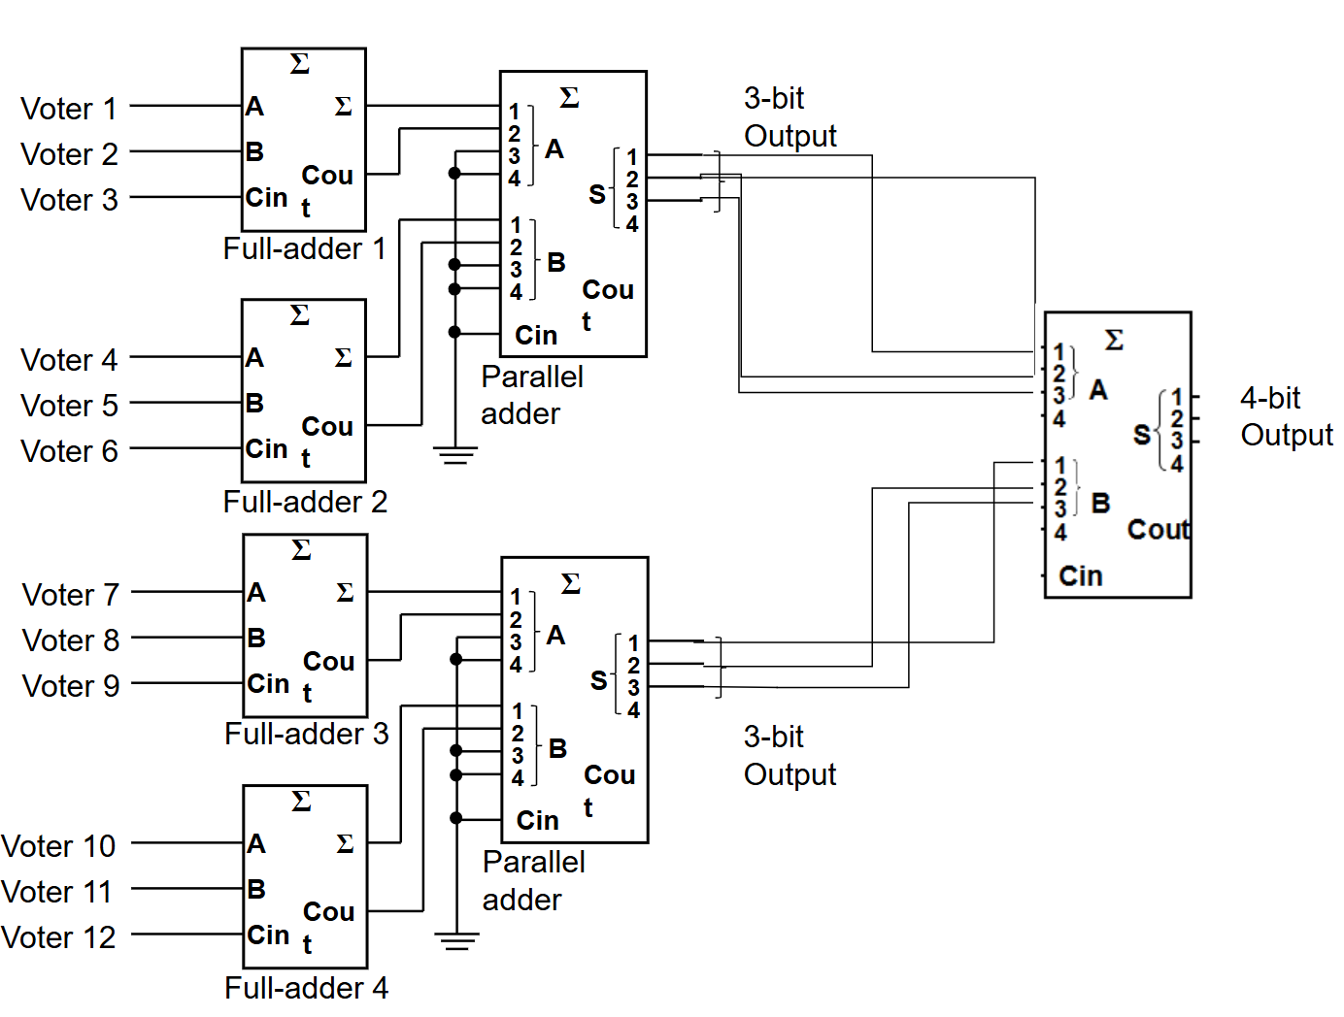
Solution of 1
Design a 12 person voting system
‹#›
Department of Computer Science and Engineering
CSE260 - Digital Logic Design

Slide 29
BCD to excess 3 code converter
Think:
A code converter that will take 4 bit BCD code as input and generate the Excess 3 output using 4 bit parallel adder.
‹#›
Department of Computer Science and Engineering
CSE260 - Digital Logic Design

Slide 30
BCD to excess 3 code converter
Solution:
Inspection of truth table of ‘excess 3 from BCD’ shows that we can get excess-3 code from BCD by adding ‘0011’ to each BCD number. This addition can be implemented by means of 4-bit full adder MSI circuit.
Let, ABCD as BCD input and WXYZ as Excess 3 output
‹#›
Department of Computer Science and Engineering
CSE260 - Digital Logic Design

Slide 31
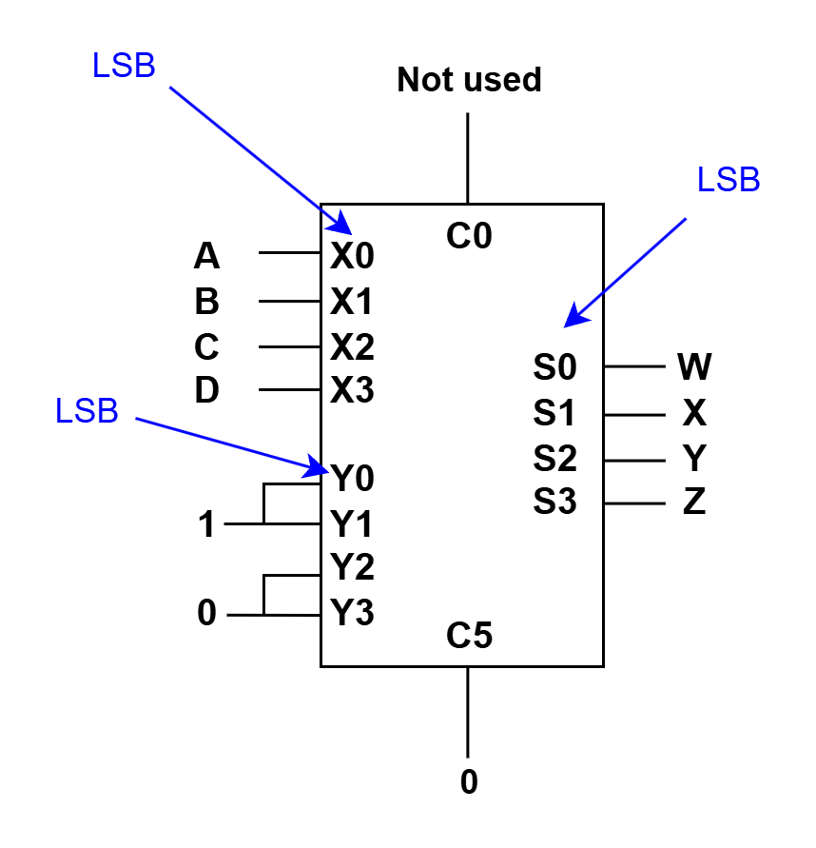
BCD to excess 3 code converter
Solution:
Let, ABCD as BCD input and WXYZ as Excess 3 output
‹#›
Department of Computer Science and Engineering
CSE260 - Digital Logic Design

Slide 32
Code Converters
Code converters – take an input code, translate to its equivalent output code.
Input
code
Code
converter
Output
code
Example: BCD to Excess-3 Code Converter.
Input: BCD digit
Output: Excess-3 digit
‹#›
Department of Computer Science and Engineering
CSE260 - Digital Logic Design

Slide 33
Overflow Detection [Self Study]
An overflow condition can be detected by observing the carry into the sign bit position (C3) and the carry out of the sign bit position (C4).
If these two carries are not equal, an overflow has occurred.
The two carries are applied to an exclusive-OR gate(XOR), an overflow is detected when the output(V) of the XOR gate is equal to 1.
Carry: 0 1
+7 0 111
+6 0 110
____ _____
+48 1 101
Carry: 1 0
-7 1 001
-6 1 010
____ _____
-13 0 011
Carry: 1 1
-3 1 101
-2 1 110
____ _____
-5 1 011
Carry: 0 0
+2 0 010
- 4 1 100
____ _____
-2 1 110
Overflow
Overflow
No Overflow
No Overflow
‹#›
Department of Computer Science and Engineering
CSE260 - Digital Logic Design

Slide 34
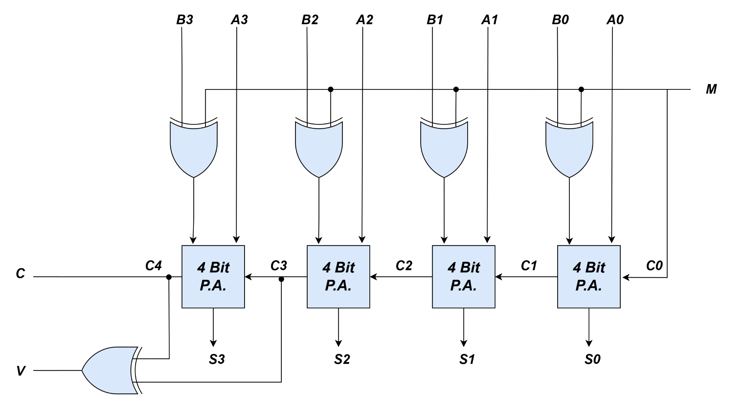
Overflow Detection [Self Study]
Full Adder
Full Adder
Full Adder
Full Adder
Figure: 4-bit Adder-Subtractor with Overflow Detection
‹#›
Department of Computer Science and Engineering
CSE260 - Digital Logic Design

